Slide 1

How to select the right Azure service
[speaker]
Notes:
What’s this session about?
There are several overlapping service offerings which could be used for a given software challenge. How do you decide when to use Azure App Service vs. VMs, Cloud Service, Service Fabric, etc.? And App Service itself has several options, so again we have the question of how to decide which one to use for a given software challenge? For example, sometimes developers spin up a Web app with an MVC application to host a single HTTP API, just because that's what they know. If they could use an Azure Function instead, they’d save a lot of money and gain a much simpler management model.
The goal of this session is to overview our PaaS offerings and explain when to use each of them.

Slide 2
Which Technology?
Which App Service?
Azure App Service
Function
Cloud Service
Logic app
Service Fabric
API App
Virtual Machine (IaaS)
Mobile App
On Premises
Web app
Notes:
First, which technology do you use? Azure App Service sits higher up on the stack as a PaaS service (more about this on the next slides).
Next, once you’ve decided to use App Service? App Service has several offerings, each of which solves a certain class of problems and offers a unique tradeoff of power, flexibility and economy.
We’ll be digging into that in this session.

Slide 3
Balance of responsibility
Responsibility | On-Prem | IaaS | PaaS | SaaS
Applications
Data
Runtime
Middleware
O/S
Virtualization
Servers
Storage
Networking
Balance of control and responsibility depends on the category of the service
MOVE-IN READY
Use immediately with minimal configuration
SOME ASSEMBLY REQUIRED
Existing services are a starting point, with additional configuration for a custom fit
BUILD FROM THE GROUND UP
Building blocks, create your own solution or apps from scratch
Customer
Microsoft

Slide 4
Benefits of Microsoft Azure PaaS Forrester total economic impact results
Interviewed organizations reported on the financial and business benefits of shifting application development and deployment from Azure IaaS to Azure PaaS
466% Return on Investment
$5.91M Net Present Value
80% IT Time Saved
50% Faster Service Deployment Time to Market
Based on five-year, risk-adjusted figures for a composite organization constructed from aggregated interviews with eight Microsoft Azure IaaS customers.
Source: “The Total Economic Impact Of Microsoft Azure PaaS,” a commissioned study conducted by Forrester Consulting, June 2016

Slide 5


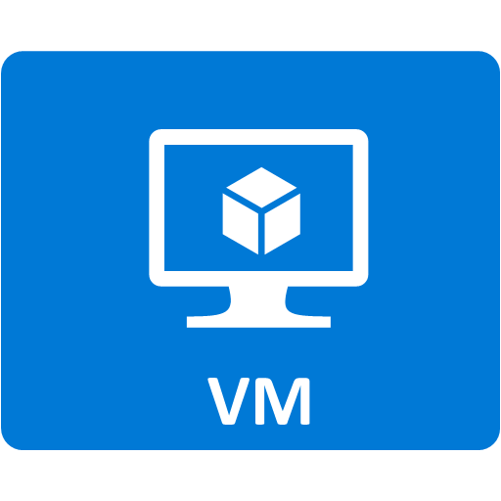
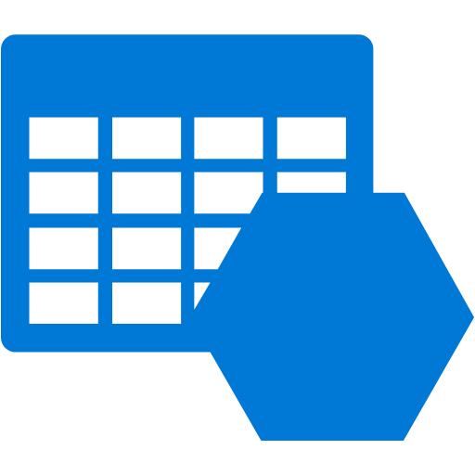

Azure Application Platform
Build on a Developer Platform (PaaS)
App Service
Service Fabric
Functions
Cloud Services
Other PaaS
Web, mobile, API, and logic apps
Massive scale, 24x7 available, multi-component
Serverless, event driven solutions
Custom monolithic 3-tier stateless apps
Cloud Foundry, OpenShift, Apprenda, Jetlastic, etc.
Build on the OS (IaaS)
Web and mobile
Microservices
Serverless Compute
Existing Frameworks
Third-party Frameworks
Virtual Machines and Containers
Storage
Networking

Slide 6
App Service

Slide 7
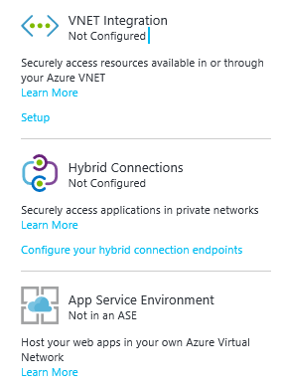
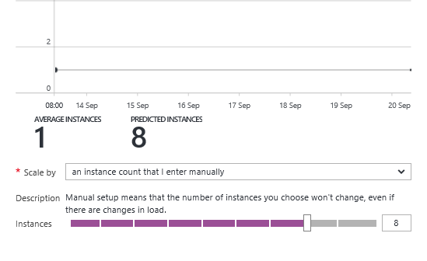
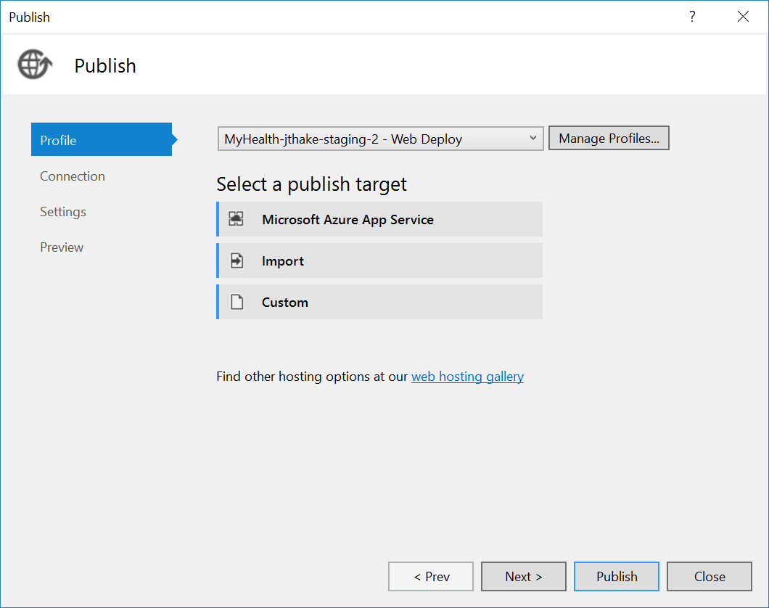
Azure App Service
Enterprise-grade apps
Fully managed platform
High productivity development

Slide 8
Azure App Service
Enterprise-grade apps
Fully managed platform
High productivity development
Global data center footprint
Hybrid support
Built-in auto scale and load balancing
High availability with auto-patching
.NET, Java, PHP, Node, and Python
Staging and deployment
AAD integrated
Secure + compliant
Reduced operations costs
Backup and recovery
Testing in production
App gallery marketplace

Slide 9


Azure App Service Build and scale great web and mobile apps
Web apps
Mobile apps
Logic apps
API apps

Slide 10
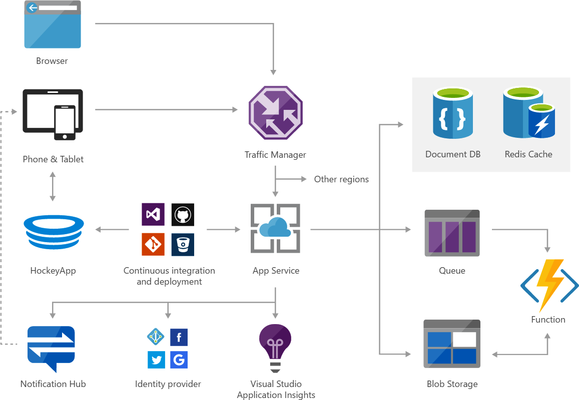
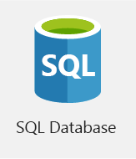
Solution architecture example

Slide 11
Azure Functions

Slide 12

Solution architecture Example: serverless mobile back ends
Photo taken and
WebHook called
Stores in blob storage
Produces scaled images

Slide 13



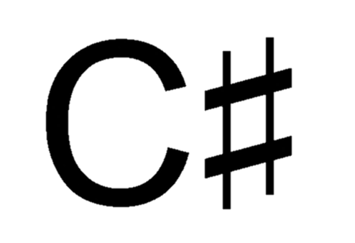

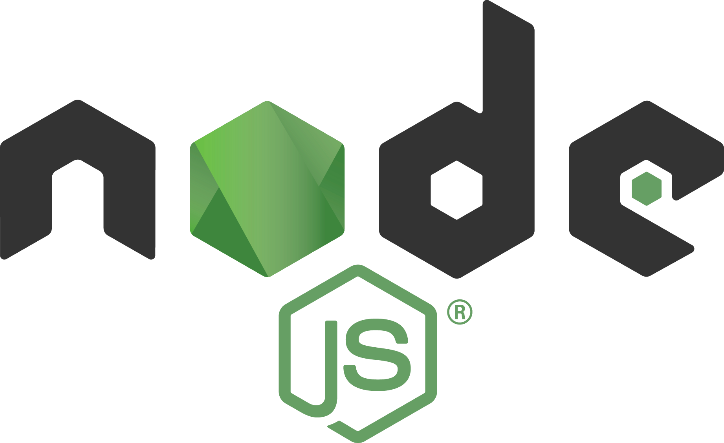







Azure Functions
Serverless
Accelerate development
Bind into services
OneDrive
Box
Twilio
</>
Dropbox
Sendgrid
Azure storage
Event-driven scale
No Ops
Develop your way
Local development
Azure queue storage
Azure event hub
AzureDocDb
Notes:
Azure Functions supports C#, F#, Node.js, Python, PHP, batch, bash, Java
Azure Functions supports the bindings in the WebJobs SDK. Some code samples here: https://github.com/Azure/azure-webjobs-sdk-extensions/tree/master/src/ExtensionsSample/Samples
For example, here’s some code showing the Twilio bindings:
public static void ProcessOrder_Declarative(
[QueueTrigger(@"samples-orders")] Order order,
[TwilioSms(
To = "{CustomerPhoneNumber}",
From = "{StorePhoneNumber}",
Body = "{CustomerName}, we've received your order ({OrderId}) and have begun processing it!")]
out SMSMessage message)
{
// You can set additional message properties here
message = new SMSMessage();
}

Slide 14
Service Fabric

Slide 15
The rise of cloud apps and microservices
Common pain points with Monolithic apps
Large apps are complex
Must redeploy the entire app on each update
Difficult to scale individual pieces
App reliability. Bug in any module can bring down the entire process
Barrier to adopting new technologies
Notes:
See https://channel9.msdn.com/Events/Ignite/2016/BRK2085-TS (1:00:46) for talking points

Slide 16
Modernization with microservices
Monolithic application approach
Microservices application approach
Small, “single role” services
Individually built and deployed. Version and update independently
Integrate using published API calls for overall application’s functionality
Fine-grained, loosely coupled application
App 1
App 1
App 2
1
3
2
4

Slide 17
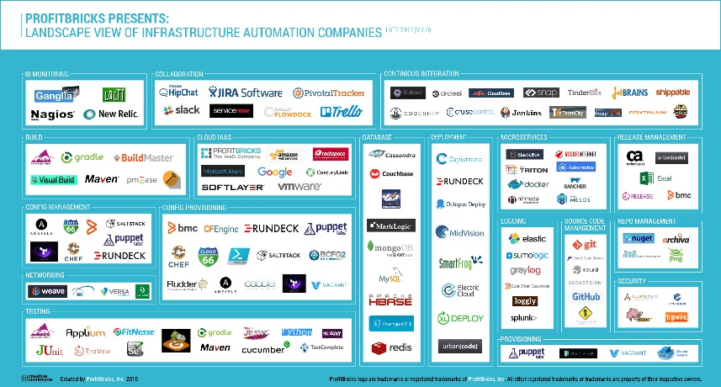
Microservice tools and approaches
Microservices in the wild
Azure Functions
Azure Service Fabric
Implication: Build your own microservices platform
Benefits: Customizable, pick best of breed solutions
Implication: Serverless microservices
Benefits: Quick ramp up, sub second metering, zero ops
Implication: Prescriptive microservices platform
Benefits: Easy to build, deploy and manage microservices at scale
Event-driven scale
No Ops

Slide 18

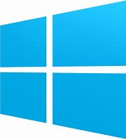

Azure Service Fabric
Lifecycle
Management
Always On Availability
Programming Models
Health & Monitoring
Dev & Ops Tooling
Auto
scaling
Orchestration
Dev Box
Azure
On Premise
Data centers
Other Clouds
Notes:
Microsoft built Service Fabric over the past 10 years and uses it heavily internally (SQL DB, DocDB, Skype for Business, Cortana, InTune)
Service Fabric is a prescriptive, opinionated framework that helps with things like lifecycle management, self-healing, rollback, auto scaling, devops integration
Runs on Windows, Linux, Azure, other clouds

Slide 19
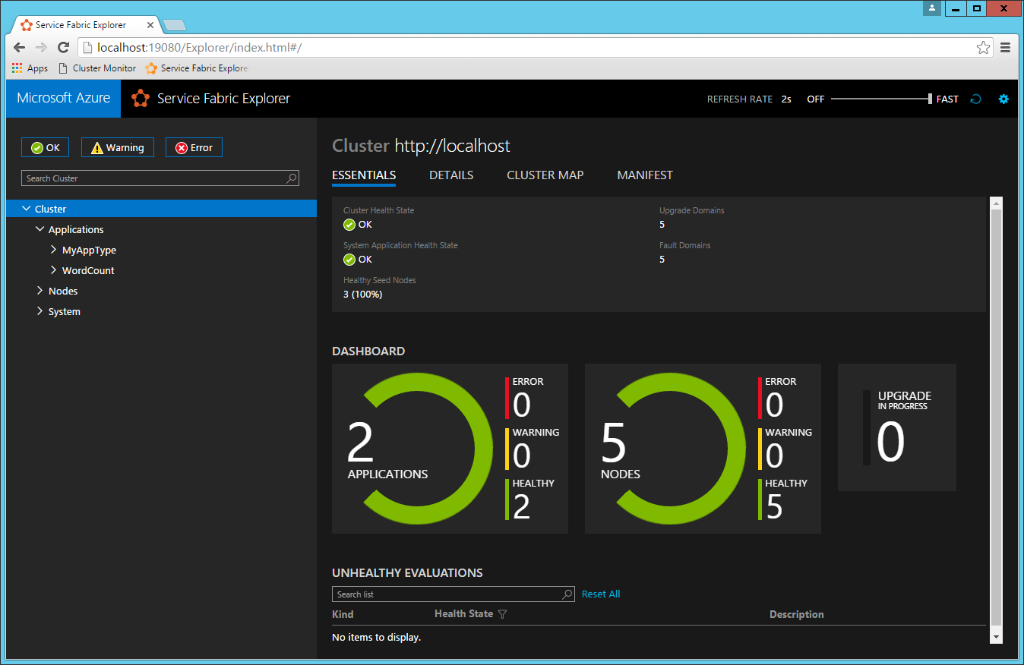
Service Fabric Explorer

Slide 20
Containers

Slide 21
Common pain points
Delivering same functionality to multiple deployment environments
Ensuring consistency and avoiding dependency hell
Unable to migrate and scale apps while maintaining compatibility
Source:
http://www.slideshare.net/dotCloud/why-docker

Slide 22
Why not just Virtualize?
Large size can make it difficult to move images easily across environments
Entire OS needs to be spun up for even writing a simple app
Lack density. Underutilization of host capacity and underlying resources

Slide 23
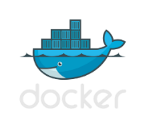



The container revolution
Standard image format for portability across environments
Virtual machine
VM-independence for efficiency, scalability and resilience
Lightweight and agile for Cloud Native apps
Virtual machine
+
Rich ecosystem of images with tools for development and operations
Containers

Slide 24
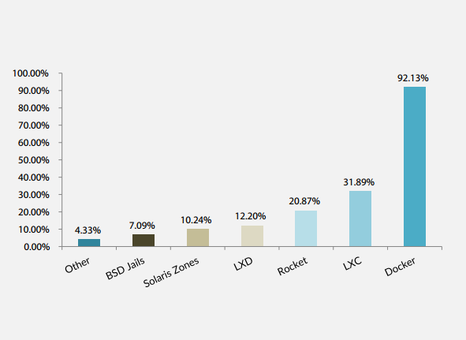
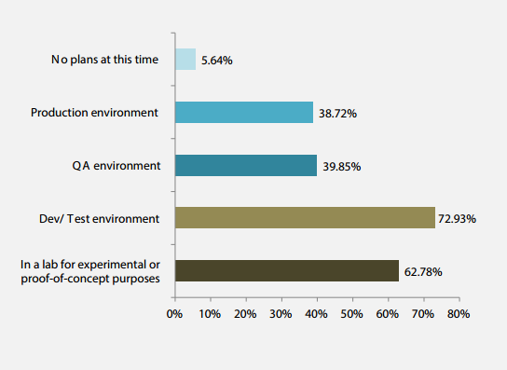
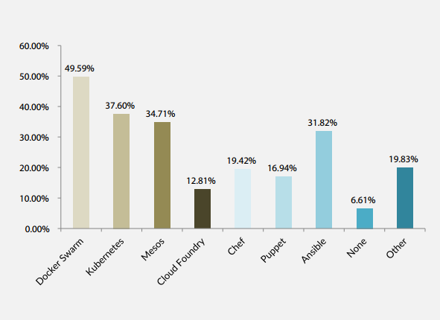
Container adoption trends
Q4 Which container technology have you used or investigated?
Answered: 254 Skipped: 31
Q8 Where are you using container technology? Choose all that apply.
Answered: 266 Skipped 19
Q12 Which container orchestration tools are you considering? (choose all that apply)
Answered: 242 Skipped: 43
* DevOp survey
https://clusterhq.com/assets/pdfs/state-of-container-usage-june-2015.pdf

Slide 25
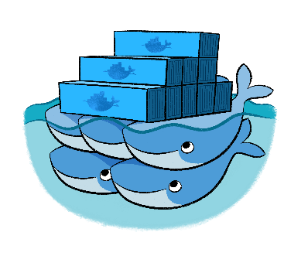

Azure Container Service
Agile, flexible and provides choice
Open source templates for provisioning your environment
Few clicks to a fully optimized enterprise grade container management solution
Mesos
Swarm

Slide 26
So what should you do next?
Azure App Service
Azure Functions
Try: https://functions.azure.com/try
Azure Service Fabric
Try: http://aka.ms/tryservicefabric
Azure Container Service
Try: http://aka.ms/acs
Try: https://tryappservice.azure.com
Download “Understanding Azure - a guide for developers” http://aka.ms/adg
The Total Economic Impact of Microsoft Azure PaaS https://azure.microsoft.com/resources/total-economic-impact-of-microsoft-azure-paas/

